Slide 1
Stairs History and Kinds
Student’s Name
University Department
Course Name/Number
Professor’s Name
Date

Slide 2

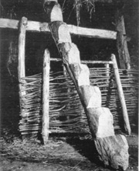

Introduction
Stairs are the oldest architectural structures in human history
However, they have changed over the years
Examine the following changes
Notes:
I want to start this presentation by pointing out that stairs is among the key architectural structures and designs that have existed for many centuries. As shown in these photos, the first stairs were not elegant or complex as those that we have today. However, this evolution of staircase construction depicts how architecture has also changed over the centuries. This presentation shows the historical changes of staircase construction and the various types of stairs that we have had in the human history.

Slide 3
The First Stairs
History shows that the first stairs were made of wood
The wood trunks were fitted together
Such stairs were used to acquire strategic positions for survival
These kinds of stairs were
made about 6,000 years
before Christ (Elevestairs.com)
They were used to perform
Simple tasks to pass difficulties
Thus, their simple feature
Notes:
The first stairs in history were made of wood trunks fitted together to help in acquiring strategic positions for survival. In other words, these stairs were not meant to carry large load or heavy things. Instead, they were meant to serve some basic functions like overcome simple difficulties like terrain or valleys. As the picture above shows, these kinds of stairs were not complex or sophisticated because they employed simple and available materials.

Slide 4
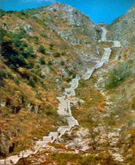
Stone Stairs
Apart from the wood stairs, stones stairs were also used
They were among the early stairs used
They were not complex
Used mainly by the religious groups
Notes:
The stone stairs were also among the earliest staircase designs in the human history. Like the wood trunk stairs, they were not sophisticated even though they served great purpose. These stairs were mainly used to climb mountains or hills when people visited sacred places. These stairs were used in China, where people visited the mountain tops where they went to pray.

Slide 5
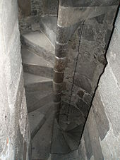

Stairs in the Second Millennium to Renaissance Period
This period started witnessing advanced architectural designs
Stairs were made from concrete or blocks
Mainly used in the construction of palaces and castles
Constructed for military purposes
Notes:
During the second millennium, advanced constructions were witnessed as more need emerged. For example, the photos shown above are among the concrete stairs constructed in the castles and palaces with one main reason, for military reasons. These stairs were strong and allowed the soldiers to defend the castles. The spiral concrete stairs shown in the second photo above shows the military tactical measure taken by the kings during this period to place their soldiers at a top advantage position when fighting with the swords (Elevestair.com)

Slide 6
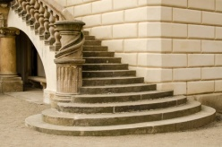
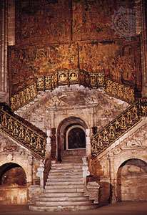
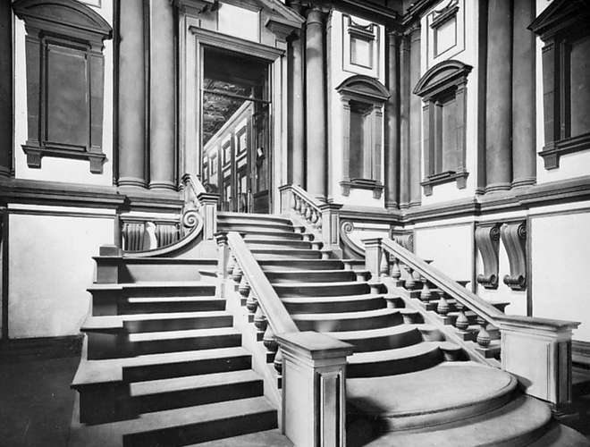
Renaissance Period
Stairs were complex and sophisticated
Most stairs were built using concrete and blocks
Importance of stairs became clear in the construction of buildings
Mainly adopted due to their durability and strength
Notes:
The above photos shows some of the stairs built during the renaissance age. The second stairs was built by Diego de Siloe in 1519 and the third stairs designed by Michelangelo in 1524 (Kuiper, 2020). Unlike the traditional stairs that were built on wood trunks, stairs in this age advanced the use of stone and marble that started in the second millennium. This was due to the durability and stability advantages that the concrete stairs presented than the wood stairs.

Slide 7
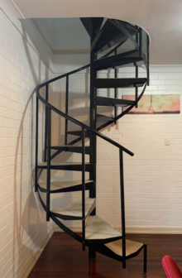
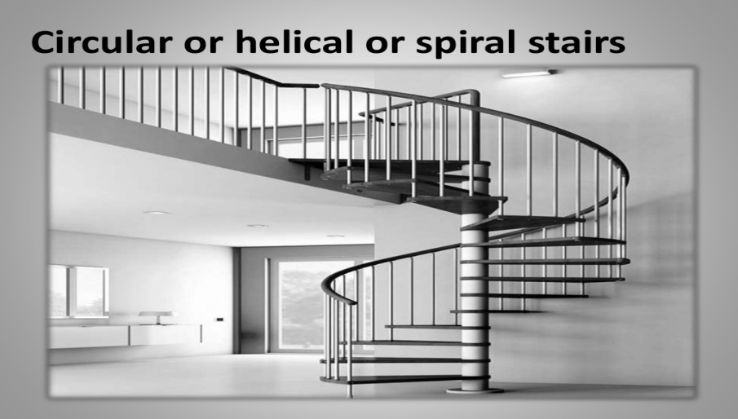
Stairs in the Modern Period
Stairs built in the beginning of nineteenth century
This period was also called the golden age of stair construction
Stairs were complex and advanced
Stairs were designed with complex features
Metal staircases became common
Notes:
The modern age saw advancement in the construction of stairs. Iron and steel became a major component in the construction of stairs. With the advancement of constructions, staircase designers became more engaged with the materials that could meet their client’s needs. For example, the above photos shows the spiral staircases made from metals, iron or steel. The flights of the stairs have been constructed to include a number of turns that may only be possible with the materials that can easily or forcefully bent like metals.

Slide 8
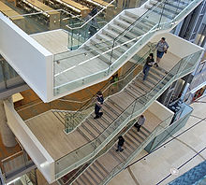
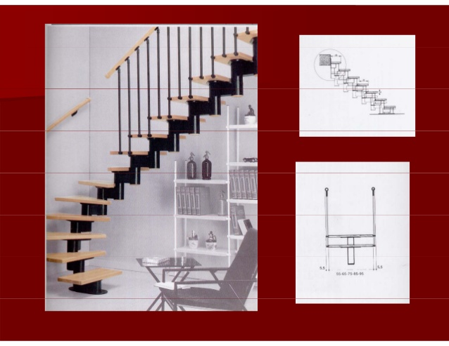
Timber Stairs in the Modern Period
Timber stairs are still common in the modern society
Constructed from timber boards
Common due to their light weight and easy construction
Timber free from fungal decay used
Poor fire resistance timber commonly used
Notes:
Timber has changed the way staircases are designed and constructed. Compared to the old timber staircases, the modern staircases are advanced and complex as shown in the above photos. The first stairs shows how wooden fascia board can be used to construct a stairs. The fascia board serves a great purpose because it covers up the trimmers as well as joists exposed to stairwell openings. The edges have been moulded to give the staircase a clearer look.

Slide 9
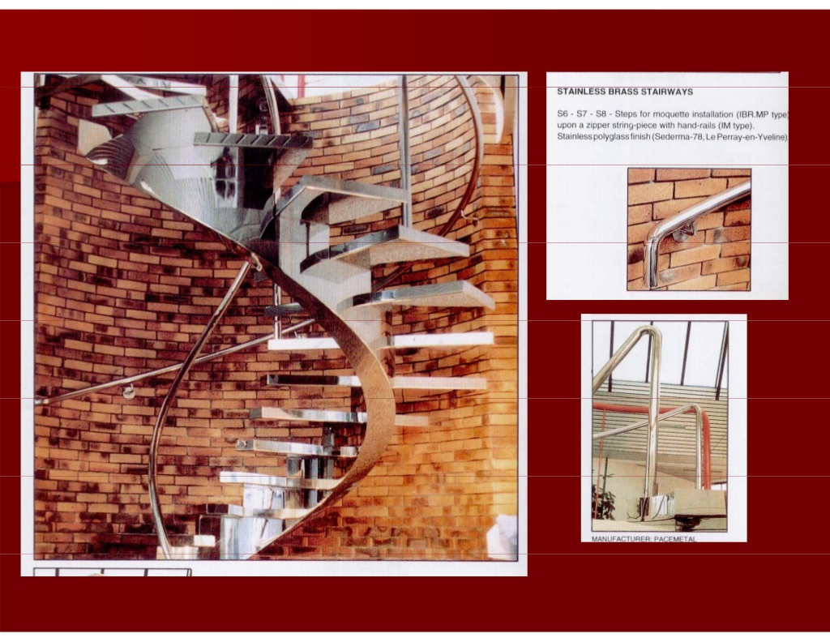
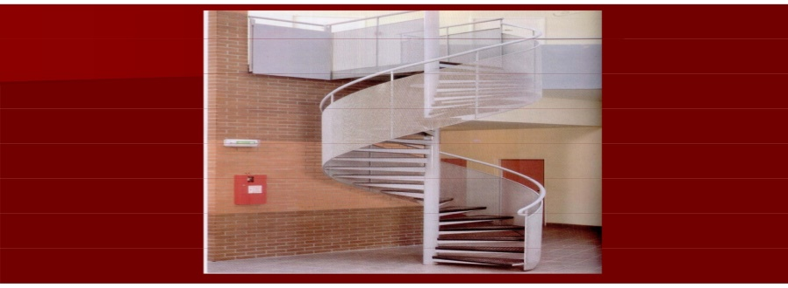
Metal Stairs
Metal stairs are fabricated from iron or steel
Used mainly where there is need for protection
Such as factories, godowns, or tall residential buildings
Convenient where
stair angles are complex
Metals can be
welded to any desired angle
Notes:
Metals have become the main material in the construction of various designs of staircases. These stairs are fabricated from iron or steel metals. They are mainly used in the areas where safety is a concern. For example, in a factory where employees need to be protected from falling. Also, they can be used in the construction of residential buildings for their strength. In the residential stairs, metals can be used for both exterior and interior use because they can be welded to suit the client’s desired model as shown in the above photos.

Slide 10
Metal vs. Wood Staircase
Most of the modern staircases combine both wood and metals
This is due to the complex nature of the stairs
Used together due their lightweight features
Construction takes few hours or days compared to concrete stairs
Appropriate for
interior stairs as
shown in these
photos
Notes:
The above photos present how construction of stairs can combine the use of both metals and timber or wood. This is another sophisticated structure that shows the advancement of staircases in the modern era. These materials are becoming common today because of their features. The stairs constructed using metal and timber can take a few days or hours compared to the concrete one, which may take days to complete. Secondly, combined together, they are more durable than when timber is used alone. Their lightweight features also make them suitable for interior stairs in the residential houses.

Slide 11

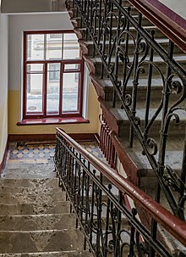
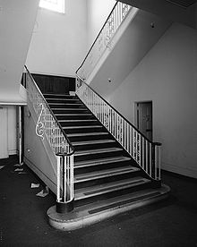
Metal vs. Concrete Stairs
Metals can also be used together with concrete
These stairs have been common since the renaissance period
Concrete is filled in steel grating
These stairs are strong and fire resistance
Most modern buildings today use this kind of stairs
Notes:
As shown in these photos, metal and concrete stairs are becoming common in most of the modern constructions. This is because they can be used in the interior and exterior staircase construction as depicted in the photos. The first stairs shows the exterior use and the other two shows the interior use. The interior is applicable in the construction where tall buildings are constructed with a stairs. The combination of the metals and concrete reduces the weight of the stairs that would reduce the stability of the whole building if concrete stairs were used alone. As shown, the concrete is filled in steel grating. These stairs are also better than the wood kinds because they are fire resistant.

Slide 12
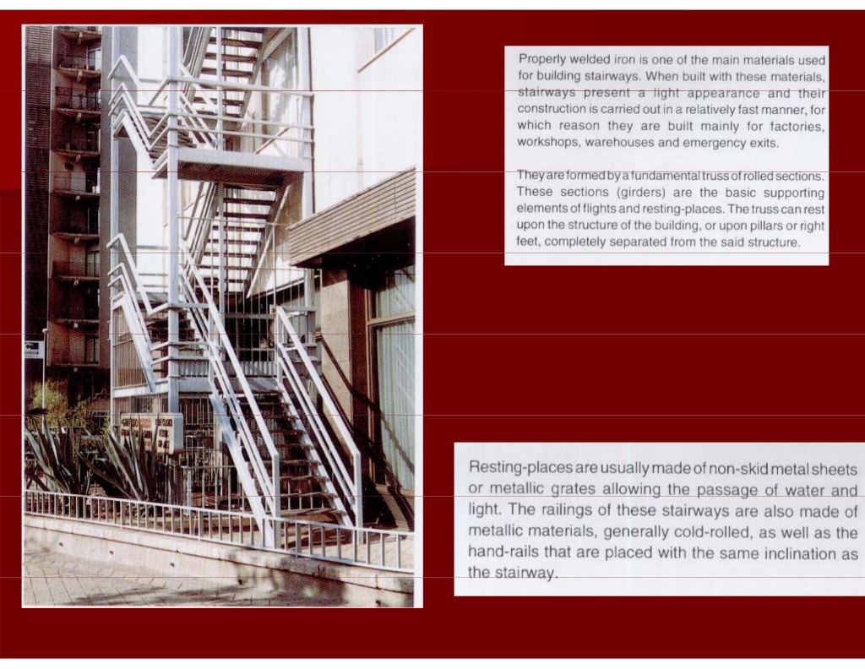
Metal Stairs above All
Metal stairs have good quality than timber or concrete stairs
Notes:
Compared to the stairs made from wood or concrete materials, metal stairs are better because they offer more durability and lightweight appearance that can be used in the construction of tall buildings. Concrete stairs add more weight to the building which may reduce the stability of tall buildings. Timber or wood stairs, on the other hand are difficult to weld to fit a certain shape or model. Also, wood stairs are not as much resistant to fire as metal stairs.

Slide 13
Conclusion
Wood stairs may have been the only option in the early days because the other materials were not available
But, today, they are still widely used in stairs construction
Their lightweight appearance makes them more appropriate
Also, they are cheap and takes shorter period to construct
Combined with metal, wood stairs are not only elegant, but cost-effective in construction
Notes:
This presentation concludes by comparing the various types of stairs that we have had in history. At first, the wood stairs were popular because they were the materials available at the moment. However, they are still used today because they present better features that architects need to complete the desired designs of houses or constructions.

Slide 14
References
Kuiper, K. (2020). “Staircase Architecture.” Encyclopedia Britannica (Online). https://www.britannica.com/technology/cellar
Stairs History (Online). Elevestairs.com. http://www.elevestairs.com/stairs-history.php

